Slide 1
Security Operations Centres and Threat Intelligence
David Crooks
Liviu Vâlsan

Slide 2
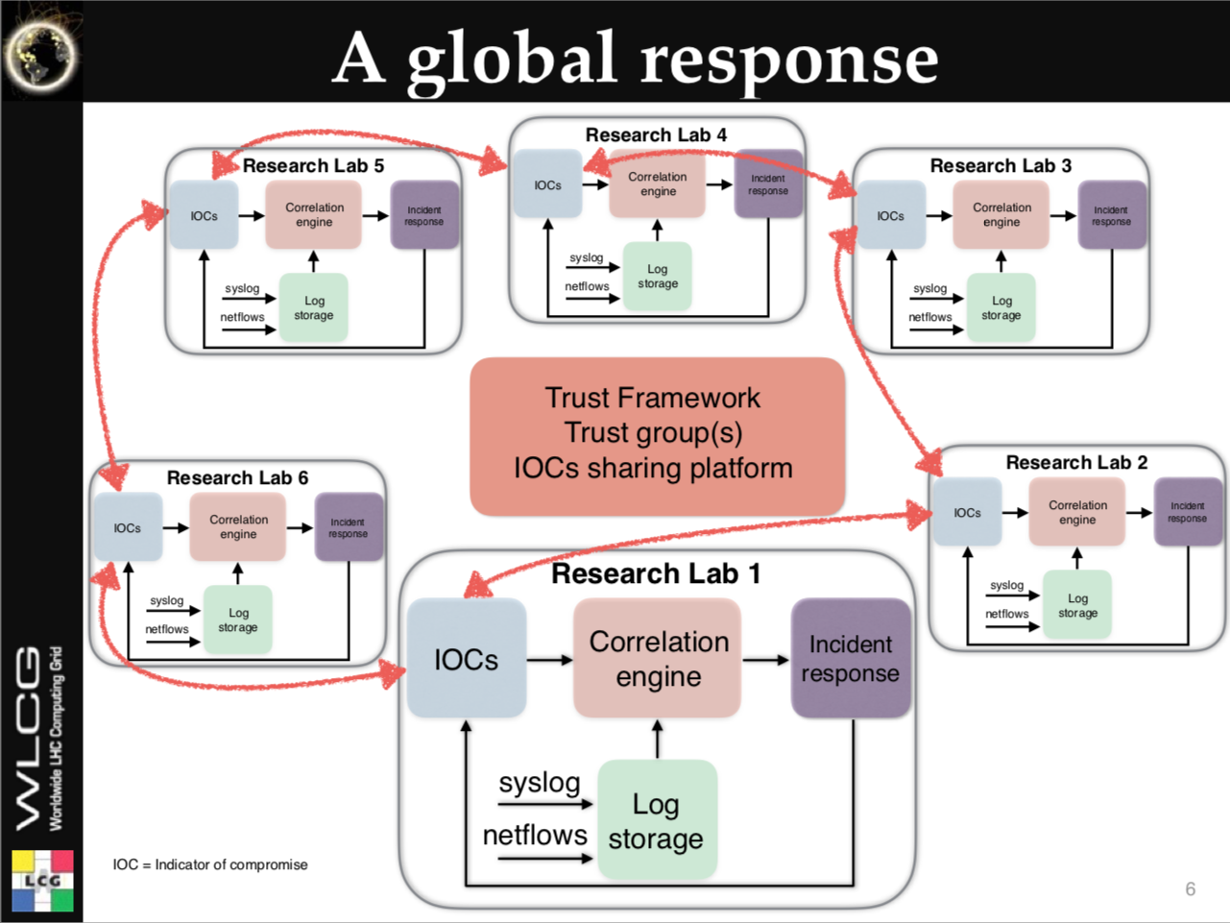
Motivation
The future of academic computing security
  Romain Wartel, CHEP2016

Slide 3
Motivation
Adversaries are motivated and well funded
  Cybercrime
  Better funded than us
Malware as a Service (MaaS)
  Ransomware
  Straightforward to spend a few dollars for a DoS
What do we have?
  Our community

Slide 4
Motivation
Within a given community (such as the WLCG), we see similar threats from similar actors
Acting together, we can establish common response mechanisms and support each other
By sharing threat intelligence we can better inform fellow sites to take action
  Active (firewall blocks)
  Passive (awareness and improved response)

Slide 5
Motivation
Grid and campus teams
Traditionally, haven’t always worked together
Additional benefit of threat intelligence
  Provide route to increase cooperation
  Grid team has intelligence
  Campus team has access to deeper (network) monitoring

Slide 6
Introduction
Key element: sharing between trusted parties
  How to achieve this?
WLCG already has a level of trust both
  via assertion
    I trust this organization so I trust this site
  years of effort

Slide 7
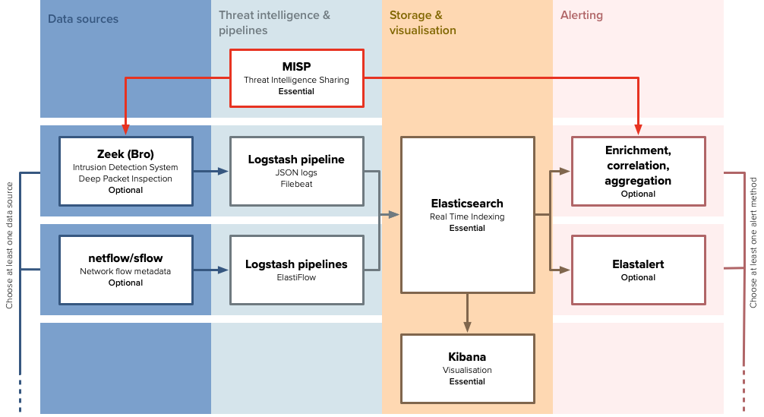
SOC WG Initial Model

Slide 8
WLCG MISP instance
Initial sharing model
  Hub and spoke
  Benefit from CERN trust frameworks and experience
TLP: GREEN and TLP:WHITE
  For now
Available to people via CERN SSO
  CERN accounts
  Federated ID with SIRTFI
    https://refeds.org/sirtfi

Slide 9
WLCG MISP instance
Start with sites pulling event data from WLCG instance
Via
  web app (visually inspect data)
  API client (direct to IDS)

Slide 10
Current status
Currently have a handful of sites that have synced to WLCG instance
Most deployments in development phase
Following SOC Workshop in February focus on threat intelligence

Slide 11
Conclusion
The technology to share intelligence already exists and is mature
  In use in many communities already
  We can benefit from this!
Need to work on the social and political process
  Use the SOC WG as a forum for this

Slide 12
PocketSOC
PocketSOC is intended as
  Demonstration of the individual components in the SOC initial model
  Testbed for adding new components (recently Elastiflow)
Docker cluster, orchestrated with docker-compose
Generally follows installation guides from wlcg-soc-wg-docs wherever possible

Slide 13
PocketSOC block diagram

Slide 14
PocketSOC block diagram

Slide 15
Contact details
Main working group page
  https://wlcg-soc-wg.web.cern.ch
Documentation
  https://wlcg-soc-wg-doc.web.cern.ch
PocketSOC
  https://gitlab.cern.ch/wlcg-soc-wg/PocketSOC

Slide 16
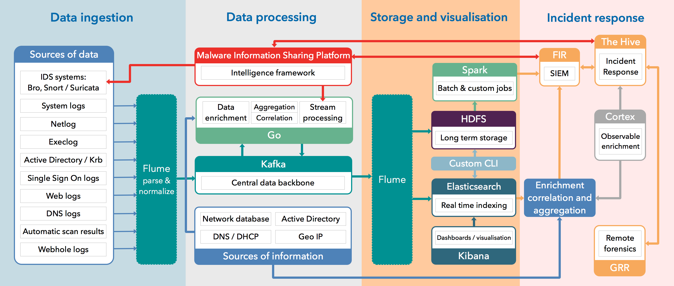
CERN SOC diagram

